Slide 1
Nationalism Triumphs in Europe
Chapter 10

Slide 2
Chapter 10 Section 1 Objectives
Identify several events that promoted German unity during the early 1800s.
Analyze the basic political organization of the new German empire.

Slide 3
Napoleon’s invasions into German-speaking states produced changes in these territories.
He dissolved the Holy Roman Empire.
He organized several German states into the Rhine Confederation.
He made trade easier in the region.
As German-speaking people fought together to free themselves from French rule, they began to consider creating a united German state.
Notes:
3

Slide 4
Creating a unified German state was difficult.
Unification would require dissolving the small governments of each German state. Instead, the Congress of Vienna created a weak alliance called the German Confederation, headed by Austria.
Prussia created an economic union in the 1830s called the Zollverein, but Germany remained fragmented politically.
In 1848, German liberals offered a throne to Prussian ruler Frederick William IV, but he rejected a crown offered by the common people.

Slide 5
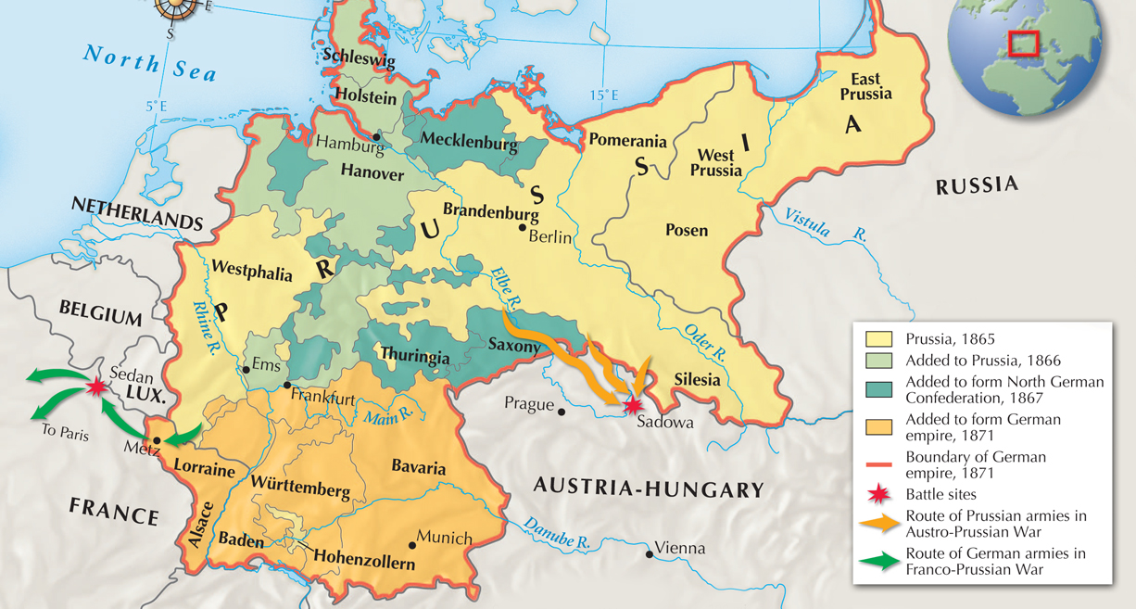
The unification of Germany under Prussian rule occurred mainly between 1865 and 1871.

Slide 6
The Franco-Prussian War broke out in 1870.
Bismarck stoked tension between France and Prussia by editing a telegram to make it appear that King William I of Prussia had insulted a French ambassador.
After a furious Napoleon III declared war, Prussia and other German states easily defeated the French within weeks.

Slide 7
Leaders in many German states urged William I of Prussia to take the title kaiser.
German nationalists celebrated the beginning of the second Reich, the second German empire after the Holy Roman Empire.
Bismarck wrote a constitution and set up a two-house legislature. However, real power remained with the emperor and chancellor.

Slide 8
Chapter 10 Section 2 Objectives
Describe how Germany became an industrial giant.
Explain why Bismarck was called the Iron Chancellor.
List the policies of Kaiser William II.

Slide 9
After Germany unified, it became the industrial leader of the European continent.
Germany’s iron and coal resources, as well as its disciplined workforce, helped make this possible.
The nation had a rapidly growing population, which fed industrialization.
Germany had also laid the groundwork for progress in the 1850s and 1860s by founding large manufacturing companies and building railroads.
Notes:
9

Slide 10
Both the government and industrialists supported scientific research and economic development.
Scientists were encouraged to develop new materials and were hired to solve technical problems in factories.
The government issued a single currency, reorganized the banking system, and coordinated railroad lines among the various German states.
During a worldwide depression in the late 1800s, Germany raised tariffs to protect home industries from foreign competition.

Slide 11
He wanted to keep France weak and sought strong links with Austria and Russia.
He did not want to compete with British naval power.
Bismarck pursued several foreign policy goals as the “Iron Chancellor” of Germany.
On the domestic front, Bismarck was ruthless.
He wanted to ensure complete loyalty to the state.

Slide 12
Bismarck began the Kulturkampf, a campaign against the Catholic Church, in 1871.
He distrusted Catholics because he believed their first loyalty was to the pope instead of the German state.
He had laws passed that increased state power over Church actions.
When Catholics rallied behind the Church, Bismarck ended the Kulturkampf in 1878.

Slide 13
In addition to Catholics, Bismarck targeted socialists.
He worried that socialists would create a revolution among German workers.
Bismarck dissolved socialist groups, shut down their newspapers, and banned their meetings.

Slide 14
When these measures failed, Bismarck sponsored laws to protect workers.
His goal was to woo workers away from socialism.
Germany became a leader in social reform with its health and old-age insurance.
Still, the socialist Social Democratic party continued to grow. By 1912, it held the most seats in the Reichstag, Germany’s legislature.

Slide 15
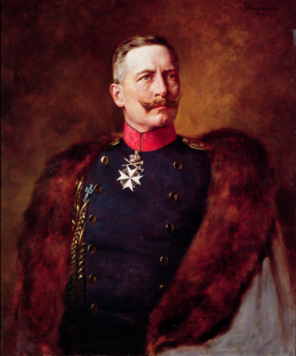
William II succeeded his grandfather William I as kaiser in 1888.
He asked Bismarck to resign as chancellor, saying, “There is only one master in the Reich, and that is I.”
He believed that his right to rule came from God.

Slide 16
William was very confident and wanted to leave his mark.
His government provided social welfare programs and services, such as public transportation, electricity, and excellent public schools.
He also developed the already huge German military, hoping to win an overseas empire like those of Britain and France.

Slide 17
Chapter 10 Section 3 Objectives
Understand the roles Count Camillo Cavour and Giuseppe Garibaldi played in the struggle for Italy.
Describe the challenges that faced the new nation of Italy.

Slide 18
Victor Emmanuel II, the monarch of Sardinia, wanted to join other states to his own and increase his power.
Cavour was a skilled politician who reformed Sardinia’s economy
His ultimate goal was to drive Austria out of Italy and annex more provinces.
He made Count Camillo Cavour his prime minister in 1852.

Slide 19
Sardinia helped Britain and France fight Russia in the Crimean War.
In the aftermath, Cavour got France to agree to help Sardinia if it ever went to war with Austria.
Cavour then provoked that war and defeated Austria with France’s help.
With Sardinia in control of northern Italy, Cavour next turned his attention southward.

Slide 20
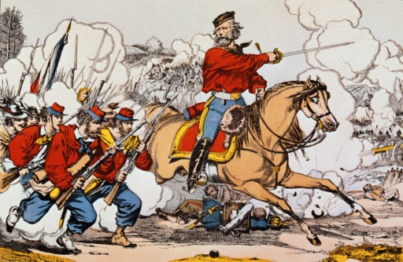
In southern Italy, Giuseppe Garibaldi led a volunteer force of 1,000 “Red Shirts.”
Garibaldi was a nationalist and ally of Mazzini.
Using weapons and ships supplied by Cavour, the Red Shirts won control of Sicily and marched toward Naples.

Slide 21
Cavour feared Garibaldi would set up his own republic in the southern part of Italy.
However, when Victor Emmanuel sent Sardinian forces to confront Garibaldi, he turned over Naples and Sicily. Victor Emmanuel II was crowned king of Italy in 1861.
Italy won the province of Venetia during the Austro-Prussian War and won Rome during the Franco-Prussian War. It was finally a united land.

Slide 22
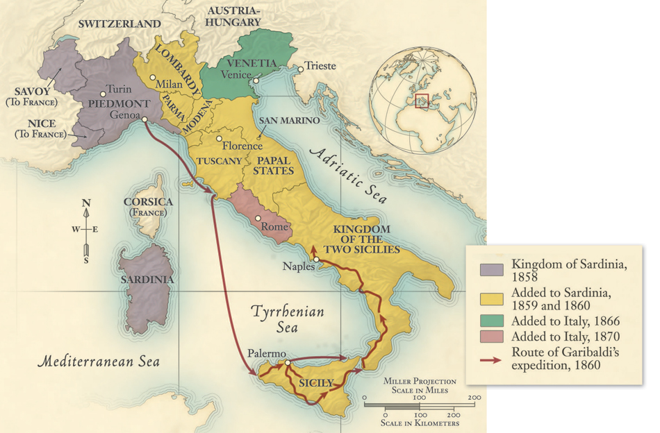
Italy became a unified state between 1858 and 1870.

Slide 23
Regional rivalries and differences made it hard to solve problems.
The north was rich and had a tradition of business and culture, whereas the south was rural and poor.
Popes resented seizure of the Papal States and urged Italian Catholics not to cooperate with the new government.
Italy faced many problems once it was unified.

Slide 24
Under Victor Emmanuel, Italy became a constitutional monarchy.
Italy had a two-house legislature.
The lower house was elected, but only a small number of men had the right to vote.
The king appointed members to the upper house, which could veto laws passed by the lower house.

Slide 25
Turmoil broke out in the late 1800s as the left struggled against a conservative Italian government.
Socialists organized strikes and anarchists turned to violence.
In response, the government extended suffrage to more men, passed laws to improve social conditions, and set out to win an overseas empire in Africa.

Slide 26
Italy developed economically, particularly after 1900.
Industries developed in northern regions and people moved to cities.
Though a population explosion created tensions, many people chose to emigrate, which calmed things at home.

Slide 27
Chapter 10 Section 4 Objectives
Describe how nationalism contributed to the decline of the Hapsburg empire.
List the main characteristics of the Dual Monarchy.
Understand how the growth of nationalism affected the Ottoman empire.

Slide 28
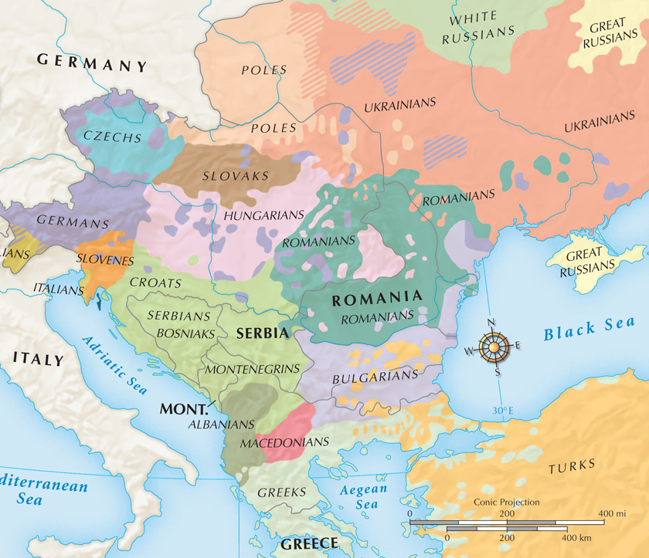
Europe was a patchwork of different nationalities between 1800 and 1914.
Nationalists pushed for self-rule, which brought about the decline of the Austrian and Ottoman empires.

Slide 29
During the early 1800s, the Hapsburg rulers of Austria tried to prevent change and ignored liberal demands.
They even tried to prevent industrialization, fearing that it would change the empire’s traditional way of life.
Nevertheless, factories sprung up by the 1840s in Hapsburg lands and caused changes, including the growth of cities.

Slide 30
Austria was an empire of very diverse people with rival goals. Nationalist feelings grew during the mid-1800s.
Nationalists made demands of the Hapsburg rulers. They wanted self-government.
A nationalist revolt broke out in 1848, and the Hapsburg government crushed it.

Slide 31
The Hungarians wanted the right to rule themselves.
During the 1848 uprising, 18-year-old Francis Joseph inherited the Hapsburg throne. He would rule until 1916.
The new emperor made some reforms including the formation of a legislature.
This did not satisfy the Hungarians, however, because the body was led by German-speaking Austrians.

Slide 32
A moderate Hungarian leader named Ferenc Deák helped to work out a solution.
The Dual Monarchy of Austria-Hungary was formed in 1867.
After Austria’s defeat in its war with Prussia, Hungarians pressured the Hapsburgs for a compromise.

Slide 33
The Dual Monarchy of Austria-Hungary
Separate
Shared
Each had its own constitution.
Each had its own parliament.
Francis Joseph ruled both, as emperor of Austria and king of Hungary.
They shared ministries of finance, defense, and foreign affairs.

Slide 34
Hungarians were happy, but others were not.
Slavic people still lacked a voice in government. Nationalist leaders called on them to unite.
Despite the compromise, nationalist unrest continued to increase in the empire.
Unrest among nationalists paralyzed governments in the early 1900s.

Slide 35
The Ottomans ruled a multinational empire that stretched from Eastern Europe to North Africa and the Middle East.
Many revolts broke out against the Ottomans in the 1800s as nationalist groups sought self-rule.
The Ottoman empire faced the same problem as the Austrian empire.

Slide 36
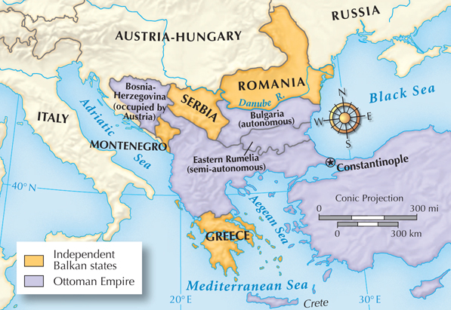
Some states gained independence from the Ottomans by 1878.

Slide 37
The Ottoman empire faced challenges from other European powers in the mid-1800s.
Russia pushed south toward Istanbul and the Black Sea.
Austria-Hungary took control of Bosnia and Herzegovina.
Britain and France eyed Ottoman lands in the Middle East and North Africa.
European powers viewed the Ottoman empire as the “sick man of Europe.”

Slide 38
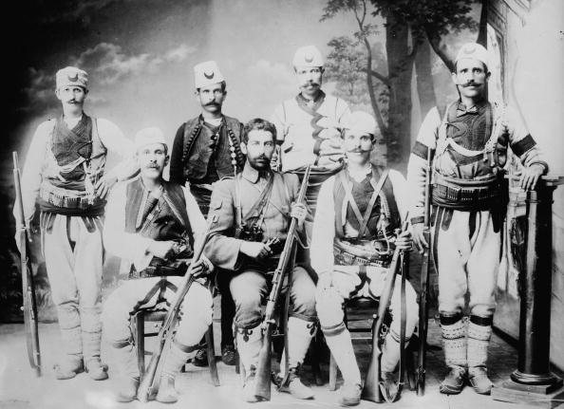
Rivalries contributed to conflicts in the Balkans.
Russia fought several wars against the Ottomans. Other powers also took sides.
Subject people revolted and then fought among themselves.
This “Balkan powder keg” would explode into World War I.
Ottoman soldiers in the Balkans

Slide 39
Chapter 10 Section 5 Objectives
Describe how nationalism contributed to the decline of the Hapsburg empire.
List the main characteristics of the Dual Monarchy.
Understand how the growth of nationalism affected the Ottoman empire.

Slide 40
Russia was a major world power by 1815, but it was also economically undeveloped.
Russia was a colossus—the largest and most populous nation in Europe—and had abundant natural resources.
However, it had a very autocratic government.
Russian rulers resisted reforms that would lead to modernization, fearing they would be a threat to absolute rule.

Slide 41
Landowning nobles at the top resisted change and reforms.
The middle class was weak and small.
Most people were serfs, bound to the land.
Many Russians knew serfdom was inefficient, but landowners had no interest in developing industry.
One obstacle to progress was Russia’s very rigid social structure.
Notes:
41

Slide 42
Tsars ruled Russia with absolute power.
Whenever the tsars made liberal reforms, they eventually canceled them to maintain the support of the nobles.
While the governments of other European nations changed, Russia remained an absolute monarchy.

Slide 43
Alexander II inherited the throne during the Crimean War in 1855.
The war began when Russia tried to seize Ottoman lands, and ended in Russian defeat.
The war showed how backward Russia was. People demanded change.
Though peasants remained poor, emancipation was a turning point that led to the drive for more reform.
In response to pressure, Alexander agreed to the emancipation of the serfs.

Slide 44
The Reforms of Alexander II
Emancipation of the serfs
Establishment of local government in the form of zemstvos, or elected assemblies
Legal reforms such as trial by jury
Reduction in military service

Slide 45
The reforms did not satisfy the Russians, who wanted a constitution or more revolutionary changes.
Socialists tried to convince peasants to rebel, which didn’t work. Radicals became angry and assassinated Alexander II.
Alexander III took the throne and embarked on a crackdown. He increased the power of the secret police and exiled critics.

Slide 46
He forced them to live in restricted areas.
Pogroms against the Jewish communities became common.
Many Jews left Russia and became refugees. A large number emigrated to the United States.
Persecution of Russian Jews also increased under Alexander III.
Groups such as Poles, Ukrainians, Armenians, Finns, and Muslims also faced persecution.

Slide 47
Russia finally industrialized during the late 1800s.
Tsar Nicholas II, son of Alexander III, focused on economic development. His government encouraged the building of railroads and secured foreign investment.
Despite progress, political and social problems worsened as workers faced poor conditions in factories and urban slums.

Slide 48
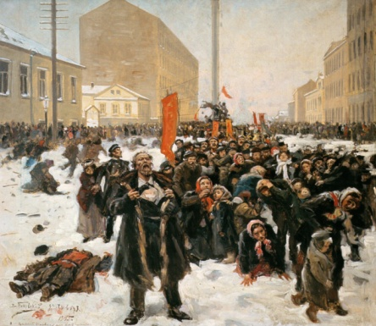
Russia entered a war with Japan in 1904 and suffered humiliating defeats.
Losses abroad fed discontent at home. Protesters poured into the streets and workers went on strike.
On a Sunday in 1905, a priest organized a peaceful march in St. Petersburg. The tsar’s soldiers fired on the crowd, killing or wounding hundreds, in an incident known as “Bloody Sunday.”

Slide 49
Discontent grew, strikes increased, and rural peasants demanded land.
Nicholas announced major reforms, including a pledge to summon a Duma.
However, the tsar dissolved the Duma in 1906. The pattern of reform and reaction continued.
Bloody Sunday was a turning point for Russians, who felt they could no longer trust the tsar.

Slide 50
Nicholas appointed Peter Stolypin as prime minister in 1906.
Peter Stolypin worked to restore order with arrests and executions.
He recognized the need for change and introduced several very limited reforms.
It wasn’t enough, and Russia still roiled with unrest. Stolypin was assassinated in 1911.

