Slide 1
Part 2
Empires of the the Ancient World

Slide 2
Read Pages 12 &13
Using your colored pencils, create a timeline(events need to be color coded to their location) from 700B.C. – 500A.D.

Slide 3
Main Ideas 2.1
In ancient India, 2 major religions developed. Buddhism and Hinduism.
Under Maurya and Gupta Empires, India grew to the center of trade.
Shi Huangdi united all of China. Under the Han rulers who followed Shi Huangdi, Chinese civilization made huge advancements.

Slide 4
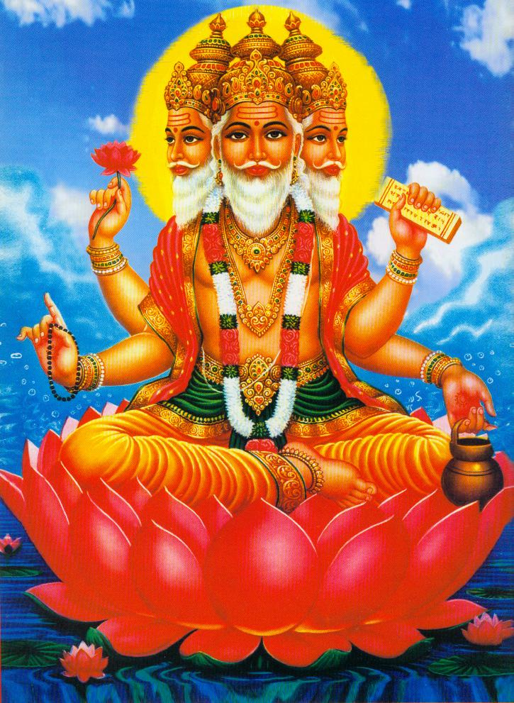
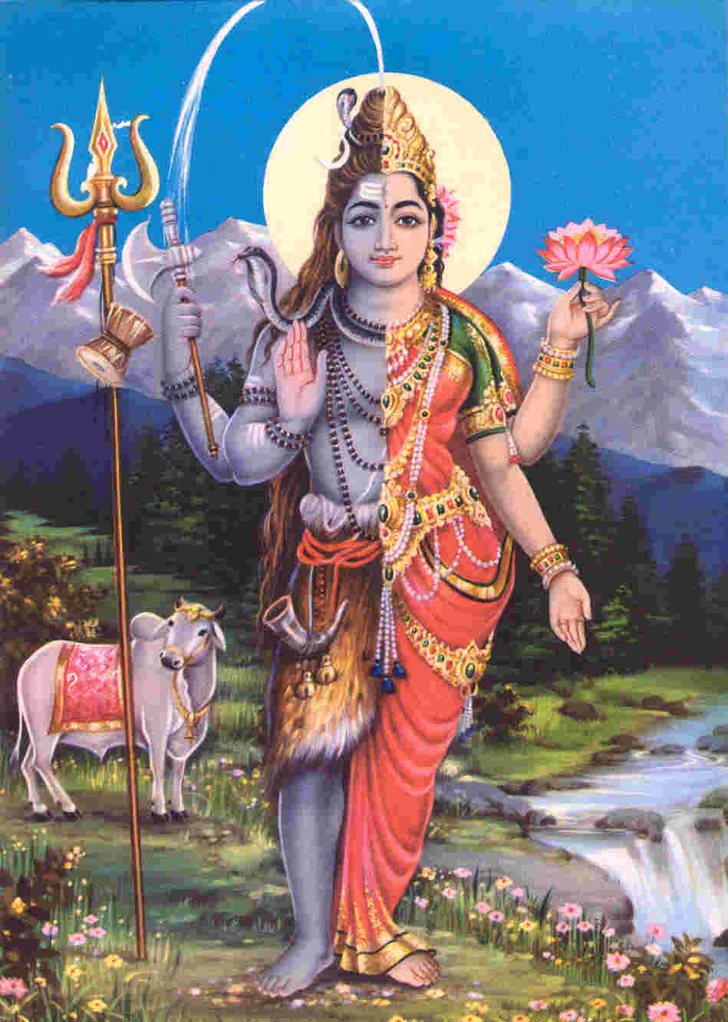
Hinduism
Brahma
Shiva

Slide 5
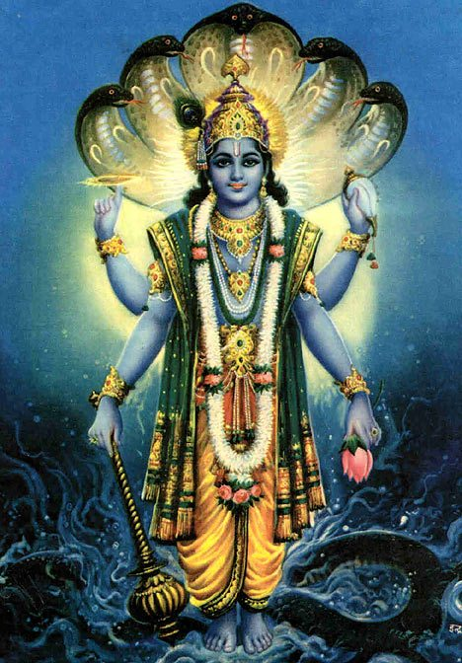
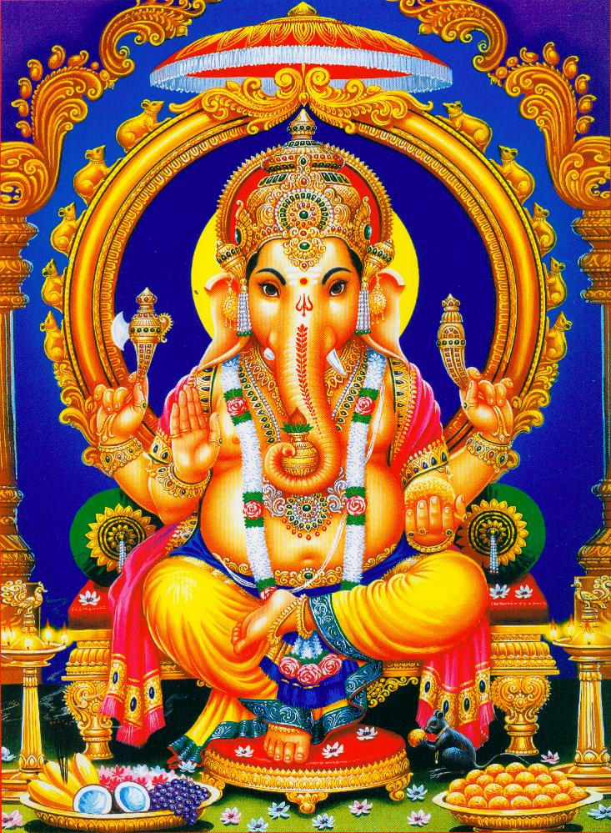
Hinduism
Vishnu
Ganesha

Slide 6


Hinduism
Ohm
Swastika

Slide 7
Buddhism
Started after 500B.C. from the teachings of Indian Prince Siddhartha Gutama.
Life is about suffering, we must follow the 8 fold path to reach enlightenment.
We will be reincarnated until we reach nirvana.
Buddhism is popular across Asia and Sri Lanka.

Slide 8
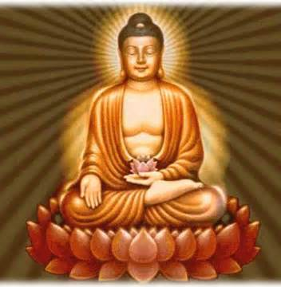
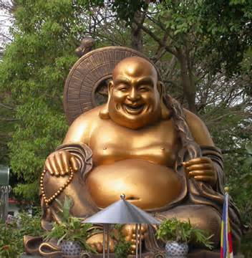
Buddhism

Slide 9
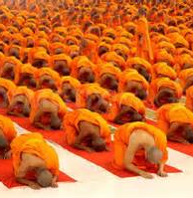
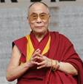
Buddhism

Slide 10


Buddhism

Slide 11
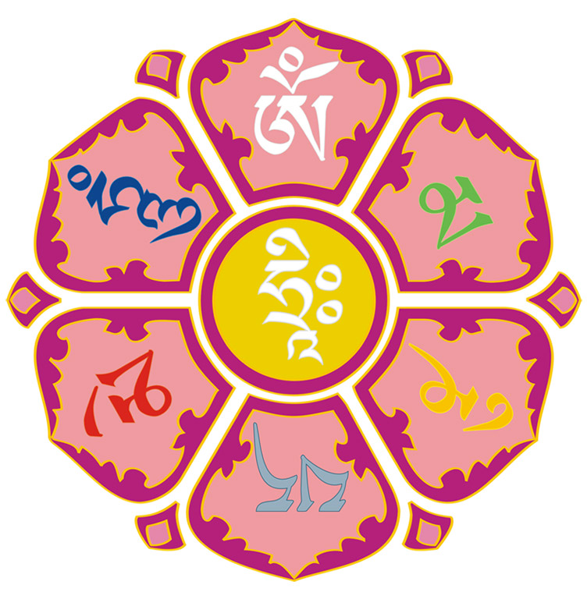
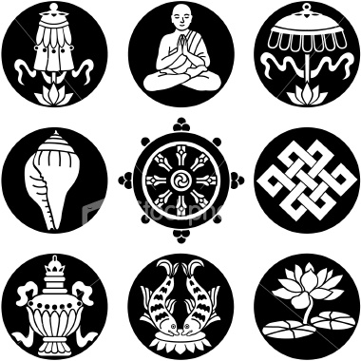
Buddhism

Slide 12
Empires of India
Maurya
Gupta
Stated by Chandragupta and continued by his grandson Asoka.
Asoka turned to Buddhism and did not continue to conquer other areas, led by moral example.
Ruled 320A.D. – 540A.D.
Is considered the golden age of peace and achievement.

Slide 13
Confucianism
Started from the teachings of Confucius, a teacher.
Not a religion as much as a system of beliefs and behavior.
Text is The Annaletics
Celebrate “Teacher’s Day”

Slide 14
Legalism
Introduced by philosopher Hanfeizi
Much different than Confucianism
Believed social order could only be attained by strict laws with very harsh punishments.
Was used be Qin Dynasty when they united China in 221B.C.

Slide 15
Daoism
Also known as “The Way”
Rose to popularity around the same time as Legalism and Confucianism
Teaches to live in harmony with nature, than to bring order to human affairs
The idea of laws and governmental control was unnatural
Read “The Tao of Pooh”

Slide 16

The Tao of Pooh

Slide 17
Unification of China
After Zhou dynasty fell, Shi Huangdi rose and unified China
Took 20 years to conquer the warring states
Built strong Gov’t and set stage for the classical age
He began the building of the Great Wall, this was very costly
The Han Dynasty followed, this marks the era of the silk road and advancements in technology, arts, and gov’t
Their reign lasted over 400 years (206B.C. – 220A.D.)

Slide 18
Main Ideas 2.2
Through trading contacts, Minoan and Mycenaean cultures borrowed many ideas from older civilizations.
After the Persian wars, democracy flourished in Athens.
Guided by a belief in reason, Greek philosophers, writers, and artists used their genius to seek order in the universe.

Slide 19
Early people of the Aegean
Minoan(1600B.C.-1400B.C.)
Mycenaean's(1400B.C.-1200B.C.)
Found on the island of Crete were traders and thought to be the earliest civilization in the region, disappeared from natural disaster
Adapted technologies from their own culture
Absorbed ideas from Mesopotamia and Egypt
Best remembered for:
  Trojan Wars (the horse)
  Homer-Iliad and Odyssey
  Honor & courage were corner stones to their ideals

Slide 20
Rise of Greek City-States
The beginning
Governing
Many settlements began popping up around the Med.
Around 750B.C. polis evolved with the acropolis (temples to the gods) on the hill top and the main city below
Originally these were monarchies, then power changed to nobles which lead to an aristocracy.
Later the merchants would come to power creating an oligarchy

Slide 21
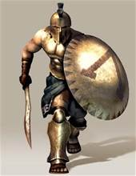
Rise of Greek City-States
Sparta
Greek city-state that adopted a warrior culture
Boys were trained from a young age to be soldiers
Women tended to handle the family estate and raise the children.

Slide 22
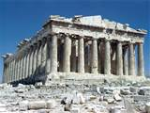
Rise of Greek City-States
Athens
This city-state developed into a limited democracy
Only men who were citizens were allowed to participate.
Became a major city with in the empire

Slide 23
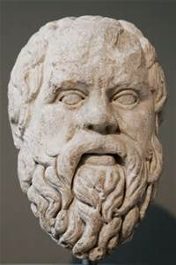
The Glory that was Greece
Known for great scholars, philosophers, artists, and writers. Plato, Socrates, and Aristotle are just a few.
Well know for their polytheistic beliefs. Zeus, Hades, Athena, and Poseidon are a few of the more well known Gods.
Many advancements were made in reason, justice, art, philosophy, poetry and drama.

Slide 24
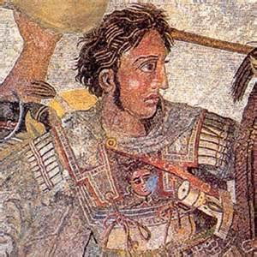
Alexander and the Hellenistic Age
While Greece warred within, Phillip of Macedonia built an army and conquered Greece.
Alexander took over at 20 yrs. old and would spend 12 years conquering everything he saw.
During his rule the civilization flourished in all aspects including art, science, math, and philosophy. This was due to the many new ideas that they were exposed to during his campaign of conquer.

Slide 25
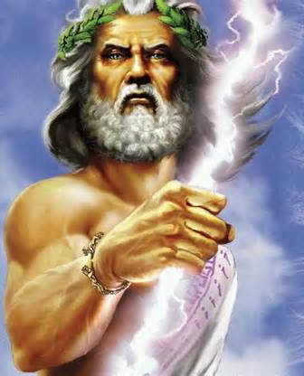
Greek Gods
Who are the Greek gods for the following:
  King
  Love
  Sea
  War
  Underworld
  Wisdom
  Messenge

Slide 26
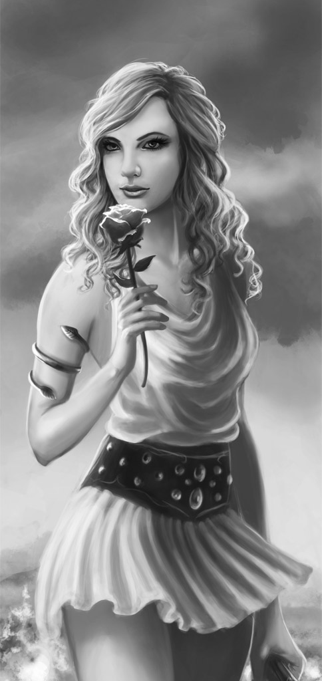
Greek Gods
Who are the Greek gods for the following:
  King
  Love
  Sea
  War
  Underworld
  Wisdom
  Messenge

Slide 27
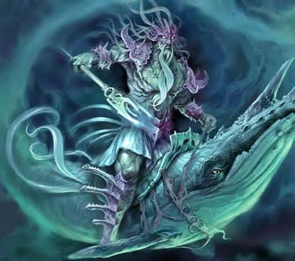
Greek Gods
Who are the Greek gods for the following:
  King
  Love
  Sea
  War
  Underworld
  Wisdom
  Messenge

Slide 28
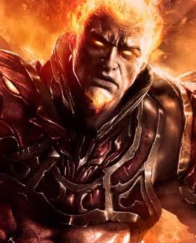
Greek Gods
Who are the Greek gods for the following:
  King
  Love
  Sea
  War
  Underworld
  Wisdom
  Messenge

Slide 29
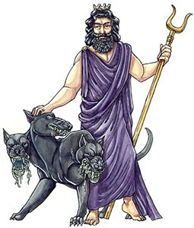
Greek Gods
Who are the Greek gods for the following:
  King
  Love
  Sea
  War
  Underworld
  Wisdom
  Messenge

Slide 30
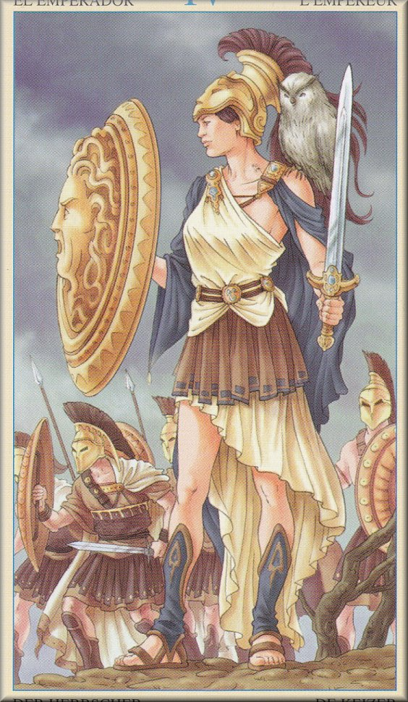
Greek Gods
Who are the Greek gods for the following:
  King
  Love
  Sea
  War
  Underworld
  Wisdom
  Messenge

Slide 31
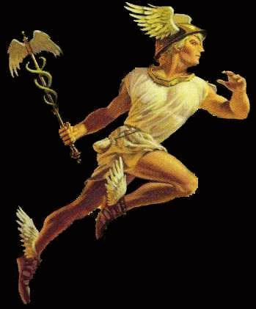
Greek Gods
Who are the Greek gods for the following:
  King
  Love
  Sea
  War
  Underworld
  Wisdom
  Messenger

Slide 32
Main Ideas for 2.3
Conquest and diplomacy helped the Romans spread their rule from Spain to Egypt
During Pax Romana, Roman Emperors brought peace, order, and prosperity to the lands they controlled.
Christianity, which began in Roman-held lands in the Middle East, spread throughout the Roman empire.

Slide 33
Roman World takes Shape
Started by over throwing the Etruscans in 509B.C. and then set up a republic
Patricians(landowners) began with power to elect officials, eventually the Plebeians(commoners) gained the power to elect officials.
Under the power of the expanding army control grew over the entirety of Italy by 270B.C. and from Spain to Egypt in 133B.C.

Slide 34
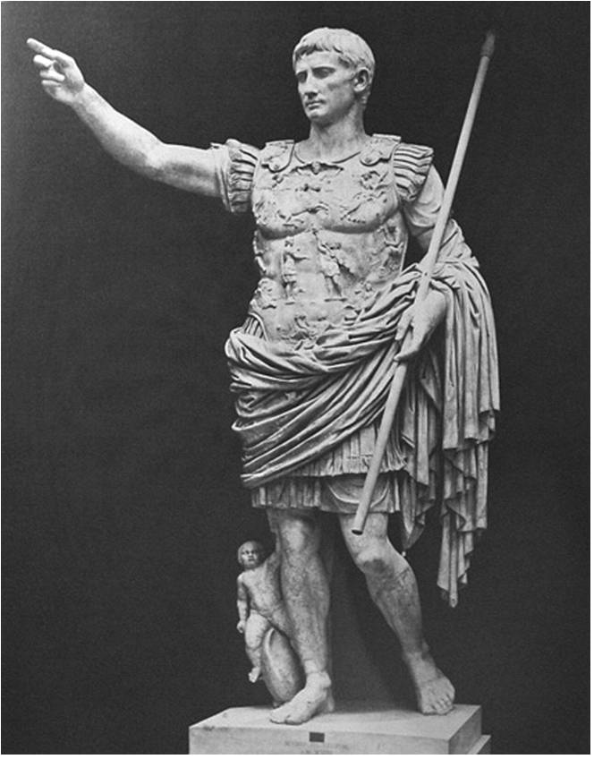
From Republic to Empire
Romans controlled many trade routes which led to much corruption and civil wars.
Octavian(Augustus) took power and restored order from 31B.C. – 14A.D. changing from Republic to Empire, becoming the 1st Emperor

Slide 35
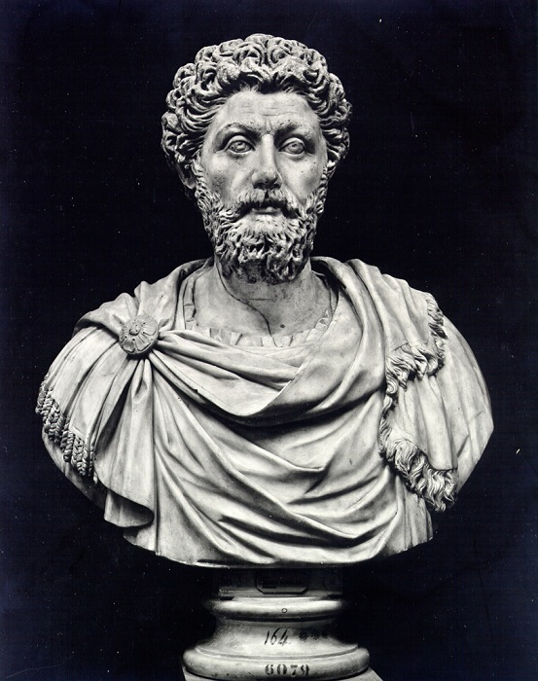
From Republic to Empire
This led to stable gov’t and economic reform.
200 year from Augustus to Marcus Aurelis is know as the Pax Romana(Roman Peace)
The Empire flourished as people could move freely and spread ideas and knowledge

Slide 36
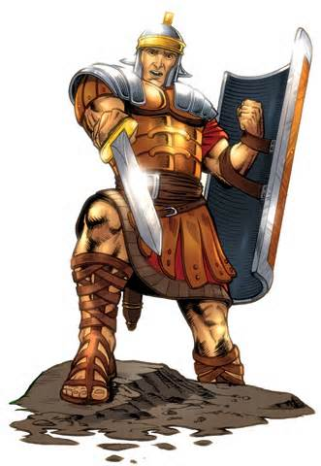
The Roman Achievement
Through conquest the empire spread to different lands and absorbed different cultures, Greek and Hellenistic becoming the Greco-Roman.
Art and engineering grew, with roads and aqueducts still in existence
Biggest influence was on the justice system and law. Basis for most judicial systems today.

Slide 37
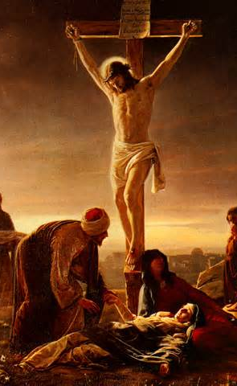
Rise of Christianity
Started in early Pax Romana with a Jew named Jesus, said the be the messiah, most of his teachings were based in the Jewish religion.
Some followed his teachings while others believed him to be a troublemaker, and he would later be executed by be crucified(common method used by the Romans at this time.
Those that continued to follow his teachings would be the 1st Christians. Their numbers grew even under persecution and eventually their beliefs would reshape those of Rome.

Slide 38
Long Decline of Roman Empire
After the death of Marcus Aurelius in 180A.D. the empire, in turmoil, would split in 2 with different rulers.
The west was plagued with corrupt rulers and would be over thrown by the Germanic people to the north. Invaders eventually captured Rome itself in 476A.D.
The east led by Constantine would grow for another 1000 years and eventually be know as the Byzantine Empire

Slide 39
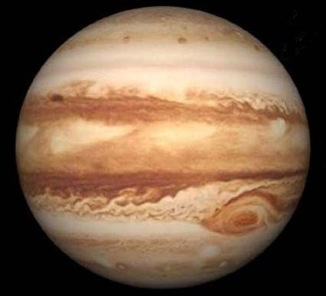
Roman Gods
How many Roman Gods can you name?
What was named after these gods?

Slide 40
Main Ideas 2.4
Between 300AD & 900AD, Mayan civilization flourished from southern Mexico to Central America. In the 1400’s the Aztecs conquered most of Mexico and built a highly developed civilization.
By the 1500’sthe Inca established a centralized government in Peru.
8 culture groups developed in North America. Their diverse ways of life were strongly influenced by geography.

Slide 41
Civilizations in Middle America
The Maya: Were a dominant civilization in Mesoamerica. Marked by pyramids, a calendar, and hieroglyphic writing system. Predicted their own end, as well as the end of the world. This civilization simply vanished during the Spanish campaign to control the area.
The Aztec: A brutal civilization that controlled Mexico. Worshiped the Sun god with sacrifices of human blood. Conquered by Cortez of Spain with the help of the local people the Aztecs had conquered.

Slide 42
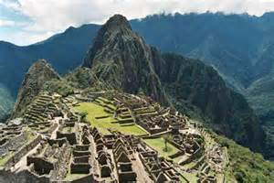
The world of the Inca
Lived in the Andes mountains of S. America. Bodies adapted to being in the mountains.
Considered themselves the children of the Sun. Built a city, Machu Pichhu, to honor the sun god. Was the fist city to have running water.
The Incas had many significant discoveries and developments during their time. They would later be conquered by Pizzaro of Spain.

Slide 43
People of North America
Puebloans
Mound Builders
Lived in SW desert
Kiva was at the center of village and was used for religious ceremony
Started building housing communities in the cliffs, which provided protection.
Would later be forced out by drought, but lived on through the Hopi and Pueblo Indians.
Lived in Ohio & Mississippi River valleys starting in 1000BC
Left earthen mounds that contained artifacts suggesting trade from the Gulf of Mexico to the Great Lakes.
Replaced by the Mississippians in 800AD who grew corn and built cities.
Variations in climate and resources encouraged different cultures including the Inuit and the Iroquois League (later known as the 5 Nations)

Slide 44
Copy down the Quick Study Guide
This can be found on page 22

